Slide 1




Smart Zone — Overview
BUSINESS DOMAIN
BUSINESS TYPE
Retail
Electronics Stores
Business Problem
The electronics retail store lacks a centralized, data-driven view of its overall business performance. Management faces difficulties in understanding sales trends, customer purchasing behavior, product profitability, store performance, and employee productivity. This makes it challenging to identify areas of strong performance, detect underperforming areas, and make informed decisions to improve sales and profitability.
Smart Zone — Electronics Retail Store
Graduation Project Documentation

Slide 2









Business Requirements & Questions
1. Sales Performance
2. Customer Analysis
3. Product Profitability
What are the total sales and how do they change over time?
Who are the highest-value customers based on total spending?
Which products generate the highest sales and quantities sold?
Which periods generate the highest and lowest sales?
Which customer segments contribute the most to sales?
Which products and categories are the most profitable?
Smart Zone — Electronics Retail Store
Requirements Engineering (Part 1)

Slide 3


Business Requirements & Questions
4. Store Performance
5. Employee Performance
6. Business Improvement
Which stores generate the highest sales and profit?
Which employees generate the highest sales?
Which products or stores have high sales but low profitability?
Which stores are underperforming compared with others?
Which employees contribute the most to profit?
What are the main opportunities for improving sales and profitability?
Smart Zone — Electronics Retail Store
Requirements Engineering (Part 2)

Slide 4








Key Performance Indicators (KPIs)
$
+$
%
Total Sales
Total Profit
Profit Margin %
Total Customers
Total Quantity Sold
Executive Dashboard Foundation
These 5 core aggregate KPIs drive the business intelligence reporting layer, offering continuous real-time monitoring and drill-down capability across stores, products, and employee tiers.
Smart Zone — Electronics Retail Store
Performance Framework

Slide 5






The Scenario
Customers have unique Customer_ID, Name, Gender, Age, City, Customer_Segment, and Registration_Date.
Products have unique Product_ID, Product_Name, Brand, Category, Unit_Cost, Unit_Price, Stock_Quantity, Product_Rating.
Stores have unique Store_ID, Store_Name, City, Region, Store_Type, and Opening_Date.
Employees work in one store with unique Employee_ID, Name, Gender, Hire_Date, and Job_Title.
Sales have unique Sale_ID, Sale_Date, Payment_Method, Order_Status, associated with one customer, store, and employee.
SaleDetail records Quantity, Unit_Price, Unit_Cost, Discount. Composite key: (Sale_ID + Product_ID).
Each sale is handled by one employee, while an employee may handle many sales.
Each employee works at one store; stores may have several employees or periods with no sales.
Smart Zone — Electronics Retail Store
Database Requirement Specifications

Slide 6
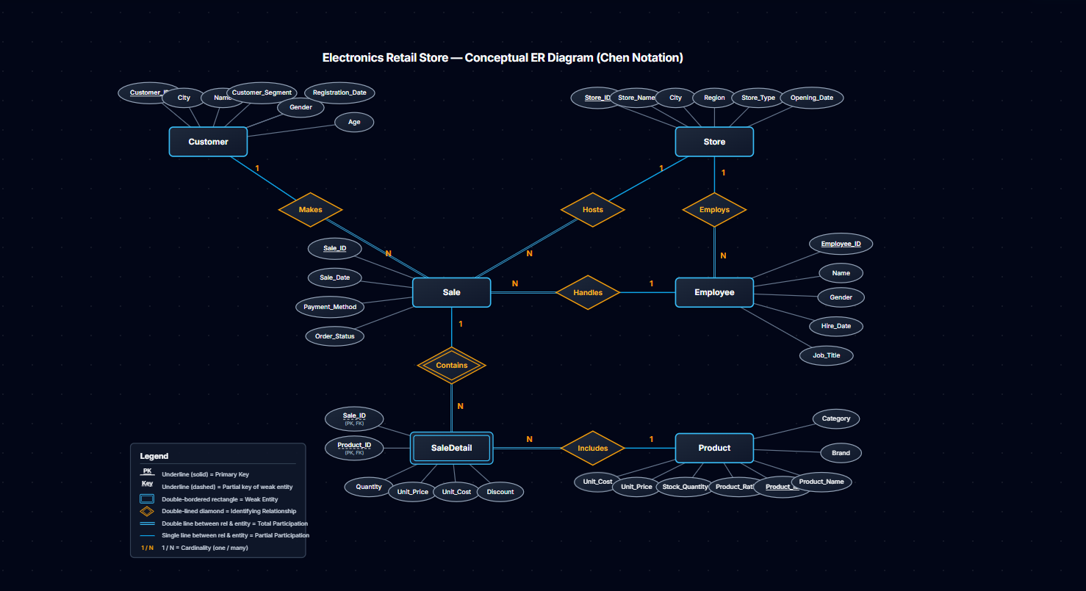

Conceptual ER Diagram (Chen Notation)
Smart Zone — Electronics Retail Store
Conceptual Data Modeling

Slide 7
Relational Schema Mapping
Table Name | Columns & Key Specifications
CUSTOMER | Customer_ID (PK), Name, City, Gender, Age, Customer_Segment, Registration_Date
STORE | Store_ID (PK), Store_Name, City, Region, Store_Type, Opening_Date
EMPLOYEE | Employee_ID (PK), Name, Gender, Hire_Date, Job_Title, Store_ID (FK)
SALE | Sale_ID (PK), Sale_Date, Payment_Method, Order_Status, Customer_ID (FK), Store_ID (FK), Employee_ID (FK)
SALEDETAIL (weak) | Sale_ID (PK, FK), Product_ID (PK, FK), Quantity, Unit_Price, Unit_Cost, Discount
PRODUCT | Product_ID (PK), Product_Name, Brand, Category, Unit_Cost, Unit_Price, Stock_Quantity, Product_Rating
Smart Zone — Electronics Retail Store
Relational Database Mapping

Slide 8



Data Dictionary (Part 1)
1. Customers
2. Products
3. Stores
CustomerID: Unique ID (PK)
ProductID: Unique ID (PK)
StoreID: Unique ID (PK)
CustomerName: Full name
ProductName / Brand: Catalog
StoreName: Branch name
Gender / Age / City: Demographics
Category: Smartphones, Laptops...
City: Branch location
CustomerSegment: Classification
UnitCost / UnitPrice: Pricing
NumberOfEmployees: Headcount
Registration Date: Sign-up date
StockQuantity / Rating: Inventory
Opening Date: Launch date
Smart Zone — Electronics Retail Store
Data Dictionary Definitions

Slide 9
Data Dictionary (Part 2)
4. Employees
5. Sales
6. SaleDetails
EmployeeID: Unique ID (PK)
SaleID: Transaction ID (PK)
SaleID & ProductID: Composite (PK, FK)
Employee Name: Staff name
Sale Date / PaymentMethod: Details
Gender / HireDate: Meta
CustomerID / StoreID / EmployeeID: Foreign Keys (FK)
Quantity: Units sold
JobTitle: Role position
UnitPrice / UnitCost: At transaction
StoreID: Branch (FK)
OrderStatus: State
Discount: Decimal (<1)
Smart Zone — Electronics Retail Store
Data Dictionary Definitions

Slide 10

Phase 2: Data Engineering
Transition to Data Cleaning & Engineering
Following the complete design of the conceptual ER model, relational schema mapping, and data dictionary specifications, the project transitions into constructing a realistic retail transactional dataset and applying dirty data distribution across multiple data engineering tools.
Smart Zone — Electronics Retail Store
Data Pipeline Architecture

Slide 11




How I Get the Data?
First, I focused on making the dataset as realistic as possible in terms of the sales period and sales volume. The sales data represents approximately six months of transactions, with the dataset size set as follows:
3,000
1,200
350
SaleDetails Rows
Sales Rows
Customers Rows
120
18
3
Products Rows
Employees Rows
Stores Rows
Smart Zone — Electronics Retail Store
Dataset Scale & Volume

Slide 12






How I Get the Messy Data?
I provided all the data cleaning tools we learned, and based on them, I intentionally created the missing and dirty data. I distributed different types of missing and inconsistent data across all tables. Each table is used as a sample for a specific cleaning tool:
Engine 1: MySQL
Engine 2: Power Query
Engine 3: Python (Pandas)
➔ Sales Table
➔ Customers & Products
➔ SaleDetails Table
Injected missing customer/employee keys and invalid status strings.
Uncleaned city names, trailing spaces, and null rating scores.
Outlier discounts, negative unit prices, and duplicate line items.
Smart Zone — Electronics Retail Store
Data Cleaning Strategy & Tool Mapping

